Slide 1
INFO 341 Security Technologies
By
Bob Larson

Slide 2
Topics Covered
User Authentication
Firewalls
Intrusion Detection Systems (IDS)
Intrusion Protection Systems (IPS)
Content Filtering / URL Filtering
Network Monitoring
Virtual Private Networks (VPN)
All-In-One Devices

Slide 3

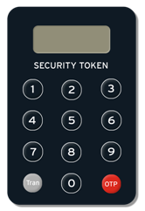

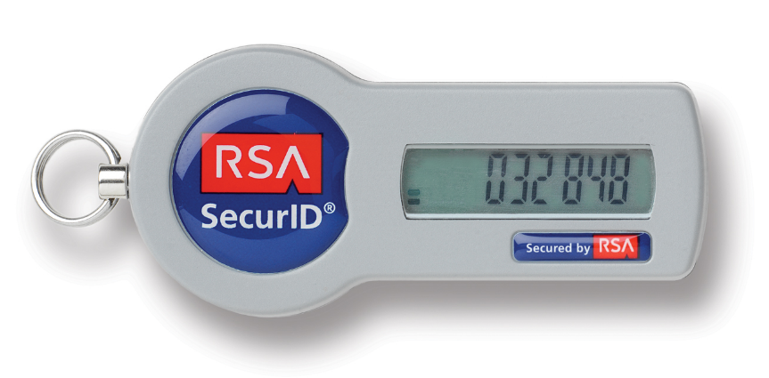
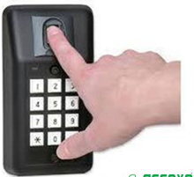
User Authentication
Mechanisms for proving who you are
Both people and devices can be authenticated
Three authentication attributes:
Something you know
Something you have
Something you are
Common approaches to Identity:
Passwords
Tokens
Digital Certificates
Biometrics

Slide 4
Password Attacks Mitigation
Require passwords to timeout – to be periodically changed
Limit password re-use
Discourage users using the same password on multiple systems
A great idea in theory
Disable accounts after a certain number of unsuccessful login attempts
Require “strong” passwords

Slide 5
Secure Passwords
Longer is harder to break
Minimum length – 8 characters (up to 256)
Think pass-phrase instead of password
Mix case, numbers & special characters
selahboy – weak
selahboy67 – stronger
SelahBoy’67 – stronger yet
Think of passwords like your toothbrush – don’t share it with anyone and change it frequently…

Slide 6
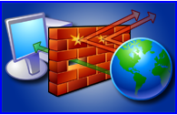
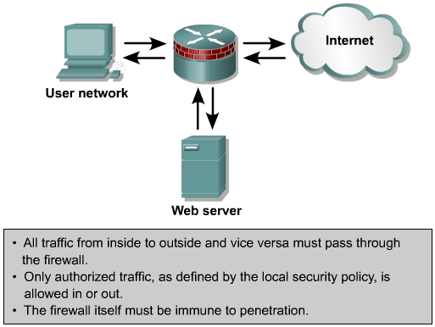
What is a Firewall?
DMZ – For “shared” resources like servers. Allows access from outside, but can only respond to requests from inside – can’t initiate.
Most firewalls use NAT to hide internal addresses from the outside.

Slide 7
Router vs. Firewall
Inside Net
or
Internet
Router
Firewall
Outbound traffic allowed
Need rule to block
Inbound traffic allowed
Need rule to block
Can have interface with any type connection
Main priority
Maximize throughput
Outbound traffic allowed
Need rule to block
Inbound traffic denied
Need rule to allow
Ethernet (Not a given anymore)
Main priority
Enforce security policies

Slide 8
Firewall Types
Appliance-based firewalls
Hardware platforms
Designed specifically as dedicated firewalls
May support other secondary functions
Intrusion Protection, VPNs
Server-based firewalls
UNIX, Linux, Windows or Novell
Warning: Vulnerabilities and resource use of the O/S must be considered
Integrated firewalls
Adding firewall functionality to an existing device

Slide 9
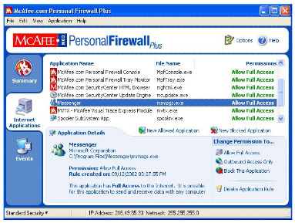


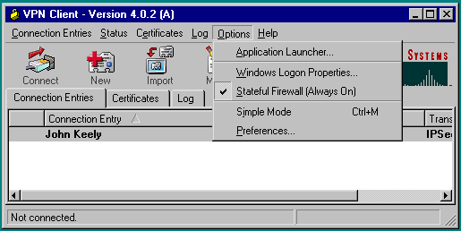
Personal Firewalls
Built into VPN Client

Slide 10
IDS, IPS and AntiVirus Protection
Lines are blurring
Antivirus software
Attempts to identify, thwart and eliminate viruses and malicious software (malware)
Examines files looking for known viruses “signatures”
Matching signatures to definitions in a virus dictionary
Intrusion Detection System (IDS)
Inspects all inbound and outbound network activity
Identifies suspicious patterns that may indicate an attack
Sends alarm to monitoring system – Admin can instigate action
Intrusion Prevention System (IPS)
Can act on suspected intrusion traffic
Break the connection and refuse re-connection
Often described as combination IDS and firewall system
Today often includes centralized SPAM and Virus protection
All are typically a subscription service

Slide 11
Attack Signatures Designations
Info – Reconnaissance
Info Atomic
Info Compound
Attack – Data manipulation, destruction or DOS
Attack Atomic
Attack Compound
Atomic – single packet can indicate threat
Compound – series of legitimate frames being used in a malicious way

Slide 12
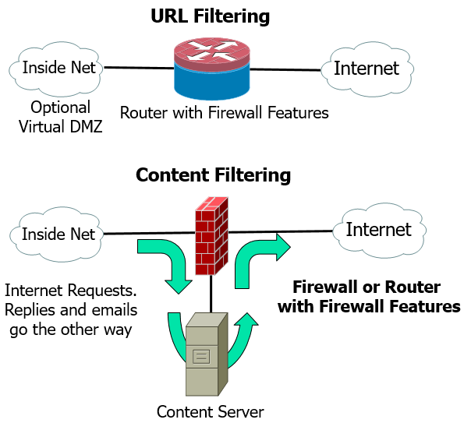
URL Filtering vs. Content Filtering
URL Filtering
Blocking web based on source address
Block inbound traffic
Block outbound requests
Keep a quick log of sites visited
Can be reviewed and then blocked
Content filtering
Blocking based on analysis of content
Widely used on Internet email and web access
More elaborate filtering may require a server
Business and Home Systems

Slide 13
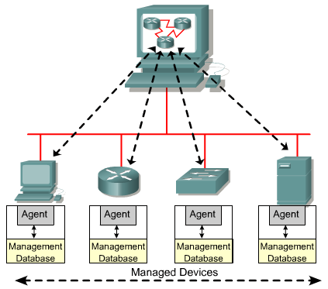
Monitor, Manage, and Audit
Security Resources

Slide 14
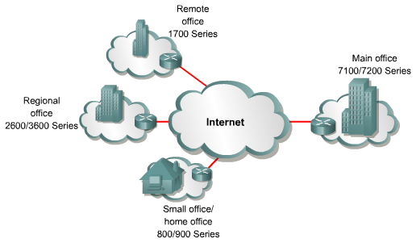
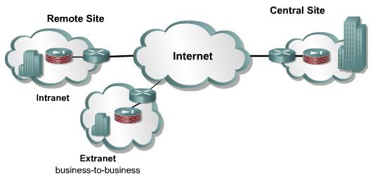
VPN Tunnels Through Internet
VPNs can create secure encrypted tunnels through the Internet
Run from perimeter to perimeter device
Run from user PC to perimeter device
Run from user PC to a server
Encryption provides the security
Not a physical tunnel
Analogies: limousine or foreign language in public
Router-to-Router
VPN “Tunnel”
VPN “Tunnel”
Firewall-to-Firewall

Slide 15
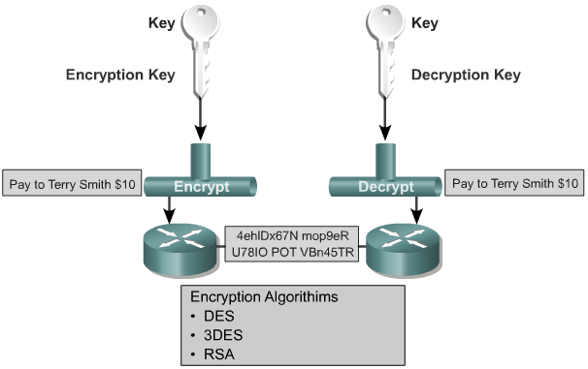
Encryption
Same key
Cornerstone to security lies in the secrecy of the key used to encrypt data!
Key is never transmitted

Slide 16
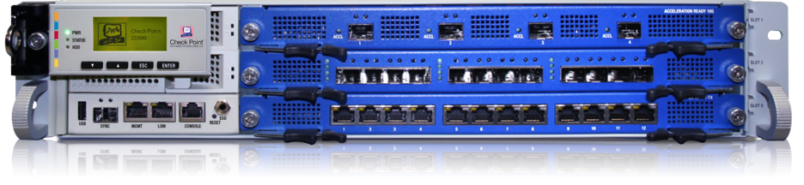
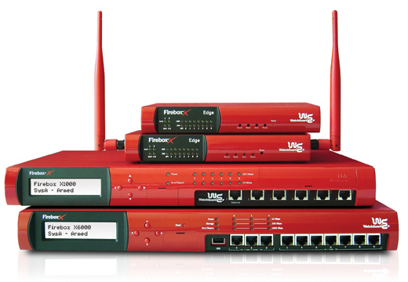
All-In-One Devices
Combines the features of:
Traditional firewalls
IDS and/or IPS services
VPN encryption services
Virus protection
Content Filtering (URL filtering)
Features may be optional
Features may require annual licensing
Regular updates
Business and Home Systems

Slide 17
Fin…

